Slide 1
Natural Selection and Mutial Aid

Slide 2
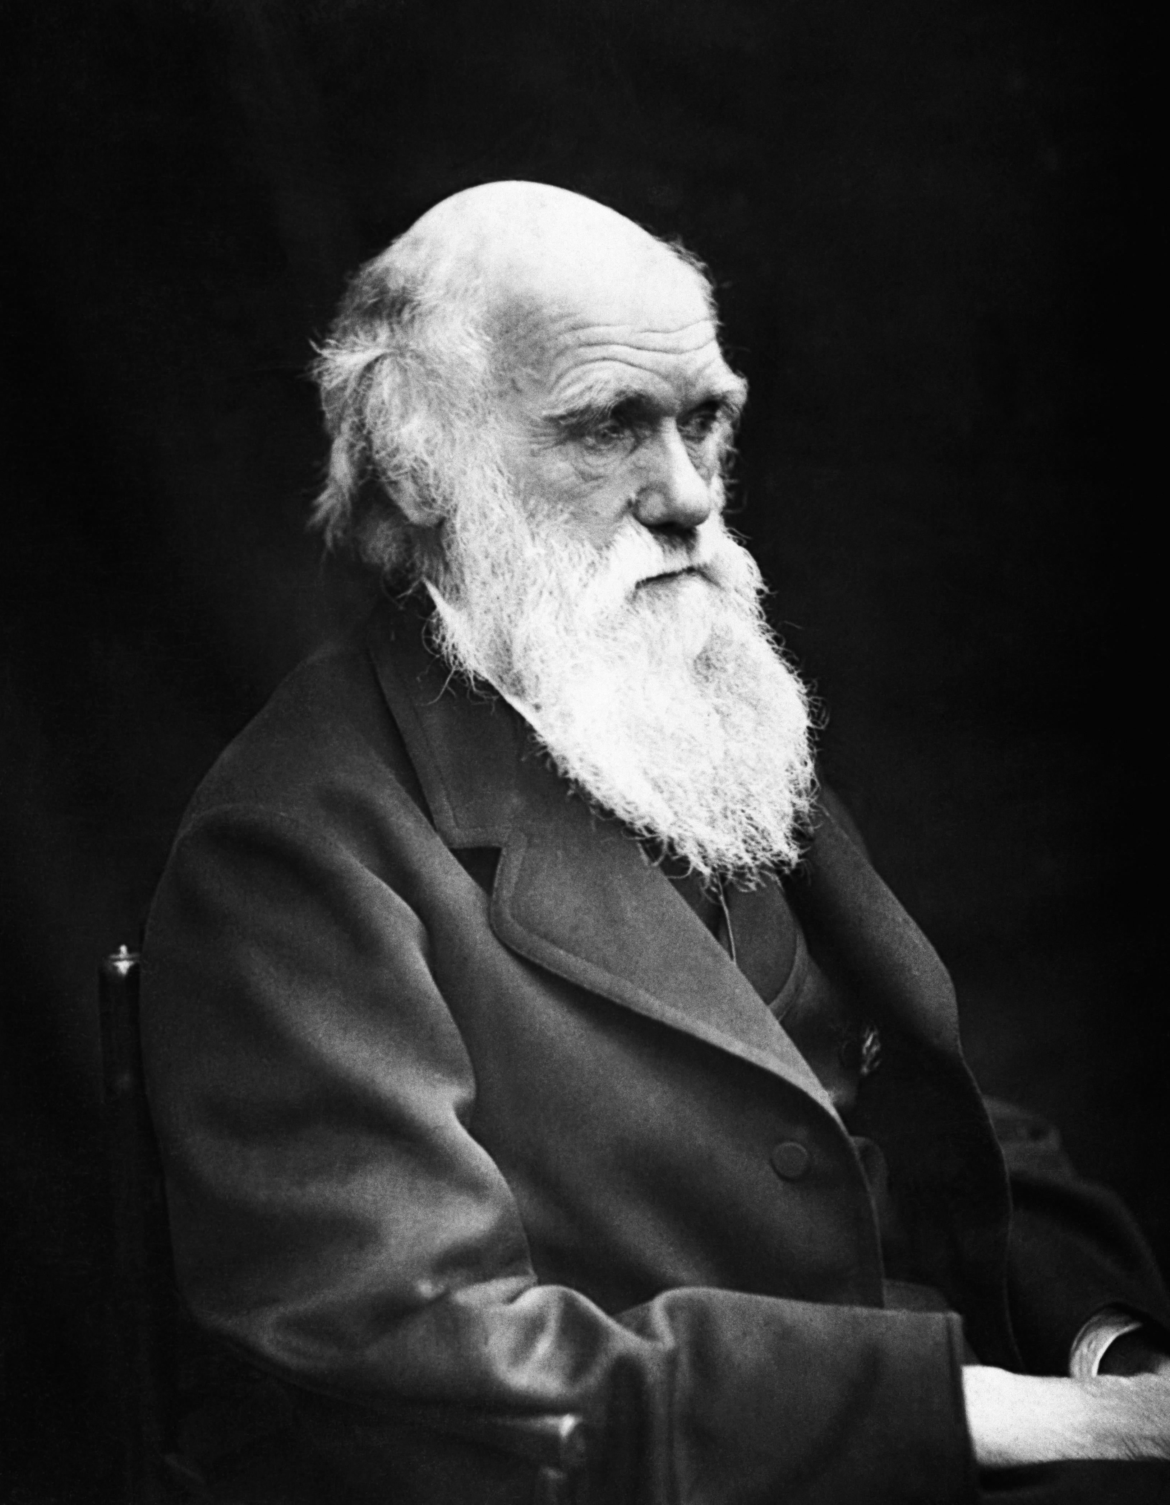
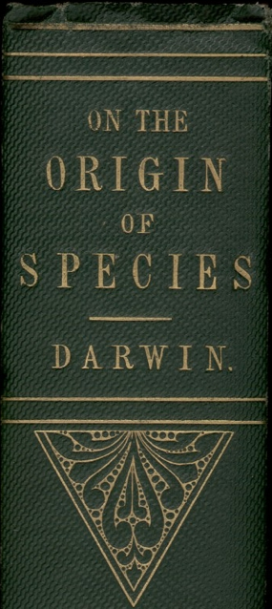
Darwinian Evolution – Natural Selection
…., if there be, owing to the high geometrical powers of increase of each species, at some age, season, or year, a severe struggle for life, and this certainly cannot be disputed; then, considering the infinite complexity of the relations of all organic beings to each other and to their conditions of existence, causing an infinite diversity in structure, constitution, and habits, to be advantageous to them, I think it would be a most extraordinary fact if no variation ever had occurred useful to each being's own welfare, in the same way as so many variations have occurred useful to man. But if variations useful to any organic being do occur, assuredly individuals thus characterised will have the best chance of being preserved in the struggle for life; and from the strong principle of inheritance they will tend to produce offspring similarly characterised. This principle of preservation, I have called, for the sake of brevity, Natural Selection.
Charles Darwin
Photo by J. Cameron, 1869

Slide 3
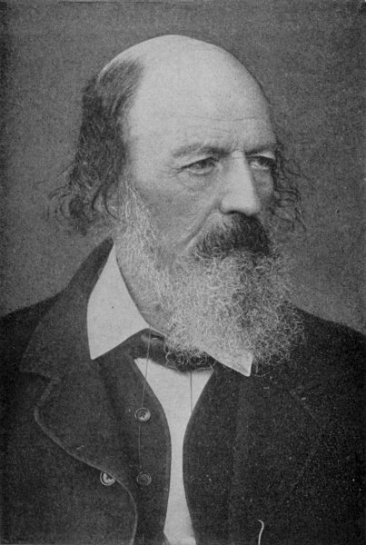
Nature, red in tooth and claw
Are God and Nature then at strife, That Nature lends such evil dreams? So careful of the type she seems, So careless of the single life;
That I, considering everywhere Her secret meaning in her deeds, And finding that of fifty seeds She often brings but one to bear,
Canto 56
Who trusted God was love indeed And love Creation's final law Tho' Nature, red in tooth and claw With ravine, shriek'd against his creed
From: Alfred Lord Tennyson's In Memoriam A. H. H., 1850 (published before Darwin's Origin of species)

Slide 4
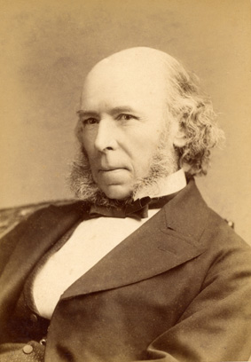
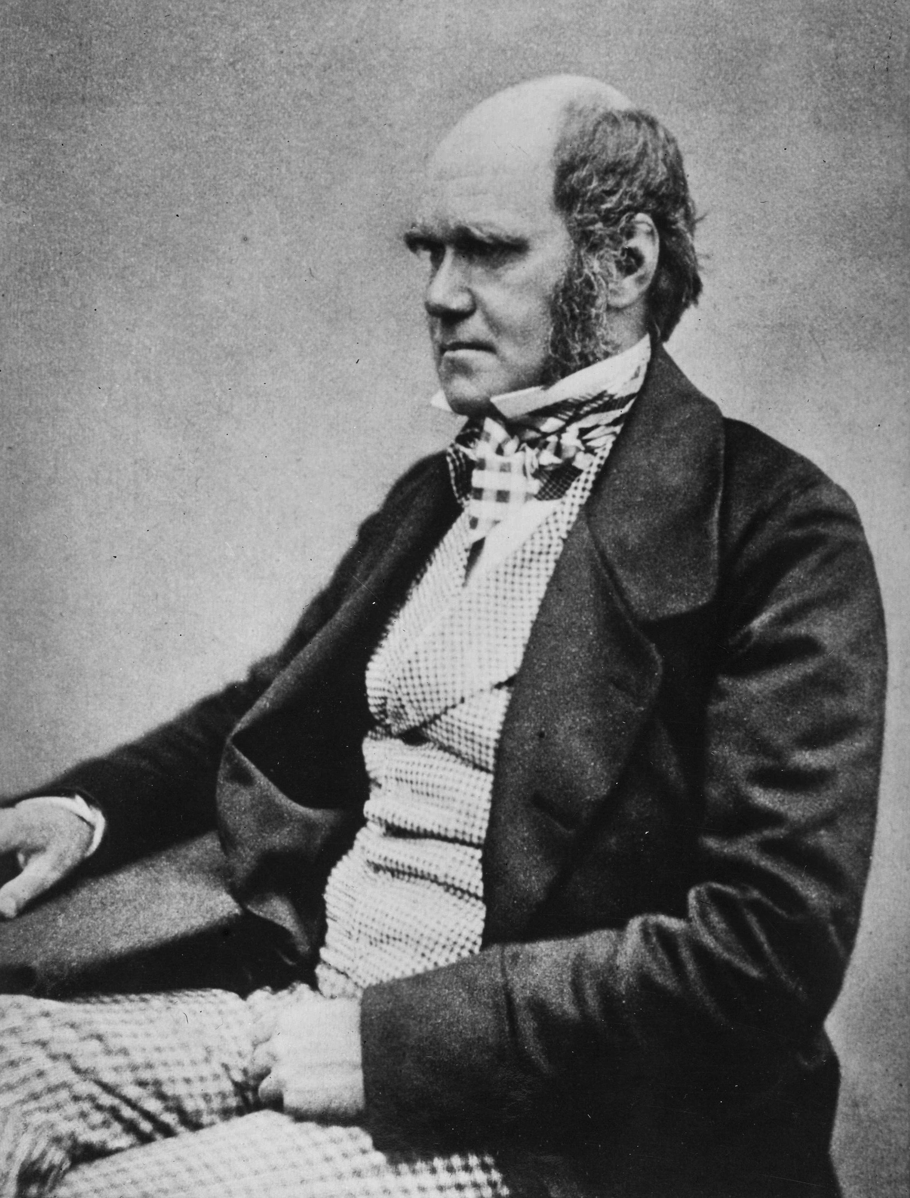
Social Darwinism and Eugenics (Spencer, Malthus, Galton)
Herbert Spencer in his Principles of Biology of 1864 wrote: 'This survival of the fittest, which I have here sought to express in mechanical terms, is that which Mr. Darwin has called "natural selection", or the preservation of favoured races in the struggle for life.'"
Charles Darwin in The Descent of Man, and Selection in Relation to Sex (1882): 'Thus the weak members of civilized societies propagate their kind. No one who has attended to the breeding of domestic animals will doubt that this must be highly injurious to the race of man. It is surprising how soon a want of care, or care wrongly directed, leads to the degeneration of a domestic race; but excepting in the case of man himself, hardly any one is so ignorant as to allow his worst animals to breed. … but there appears to be at least one check in steady action, namely that the weaker and inferior members of society do not marry so freely as the sound …
Charles Robert Darwin, aged 45 in 1854
Images from Wikipedia

Slide 5
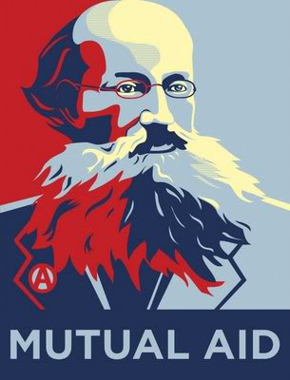
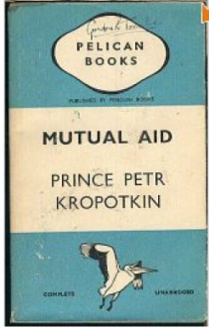
Prince Pyotr Alexeyevich Kropotkin Mutual Aid: A Factor of Evolution
Russian Anarchist; organized geographical survey expedition to Siberia and Manchuria; spent most of his life in Switzerland, France (Paris commune), and England; returned to Russia after the 1917 revolution, but did not like the Bolsheviks and spoke out against authoritarian socialism.
Chapters written 1890-96
Critique of the "Struggle for Existence".
Raises the question "Who are the fittest?"

Slide 6
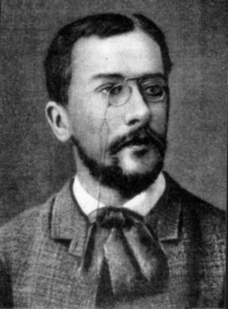
Symbiogenesis
Konstantin Mereschkowski:
The nature and origins of chromatophores in the plant kingdom (1905)
The Theory of Two Plasms as the Basis of Symbiogenesis (1909)
Natural selection cannot create novelty. → Acquisition and inheritance of microbes
(see also Lynn Margulis' theory of serial endosybiosis)

Slide 7
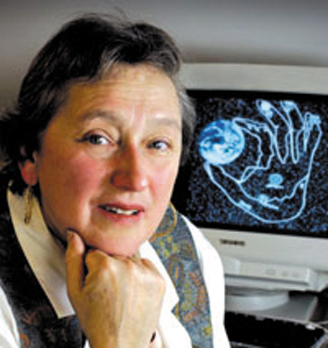
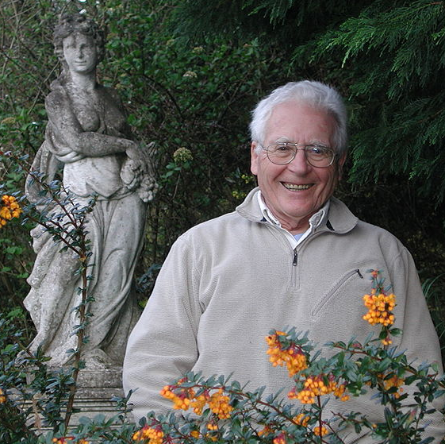
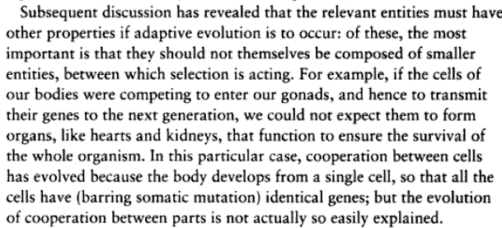
Gaia Hypothesis Lynn Margulis, James Lovelock
Ecosystems (including the whole biosphere) can be seen as super organisms with their own homeostatic mechanisms.
Problems: A single organisms cannot evolve by natural selection. Both positive and negative feed back loops exist in the biosphere.
John Maynard Smith in Connie Barlow's "From Gaia to Selfish gene":
Images from Wikipedia

Slide 8
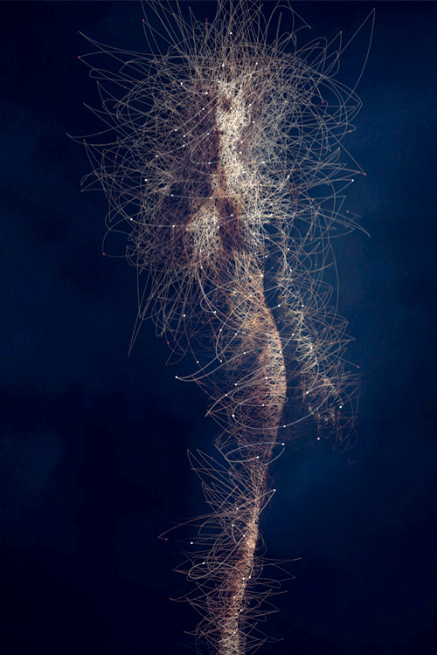
Holobiont and Evolution
Holobiont = Host plus all its Symbionts
In science symbiont is usually defined as living together, i.e. the term includes mutualistic, commensal and parasitic interactions.
The fitness of the Holobiont is the arbiter of selection.
The Hologenome Theory of Evolution
Image: BODY MICROBES, by Bruno Vergauwen.

Slide 9
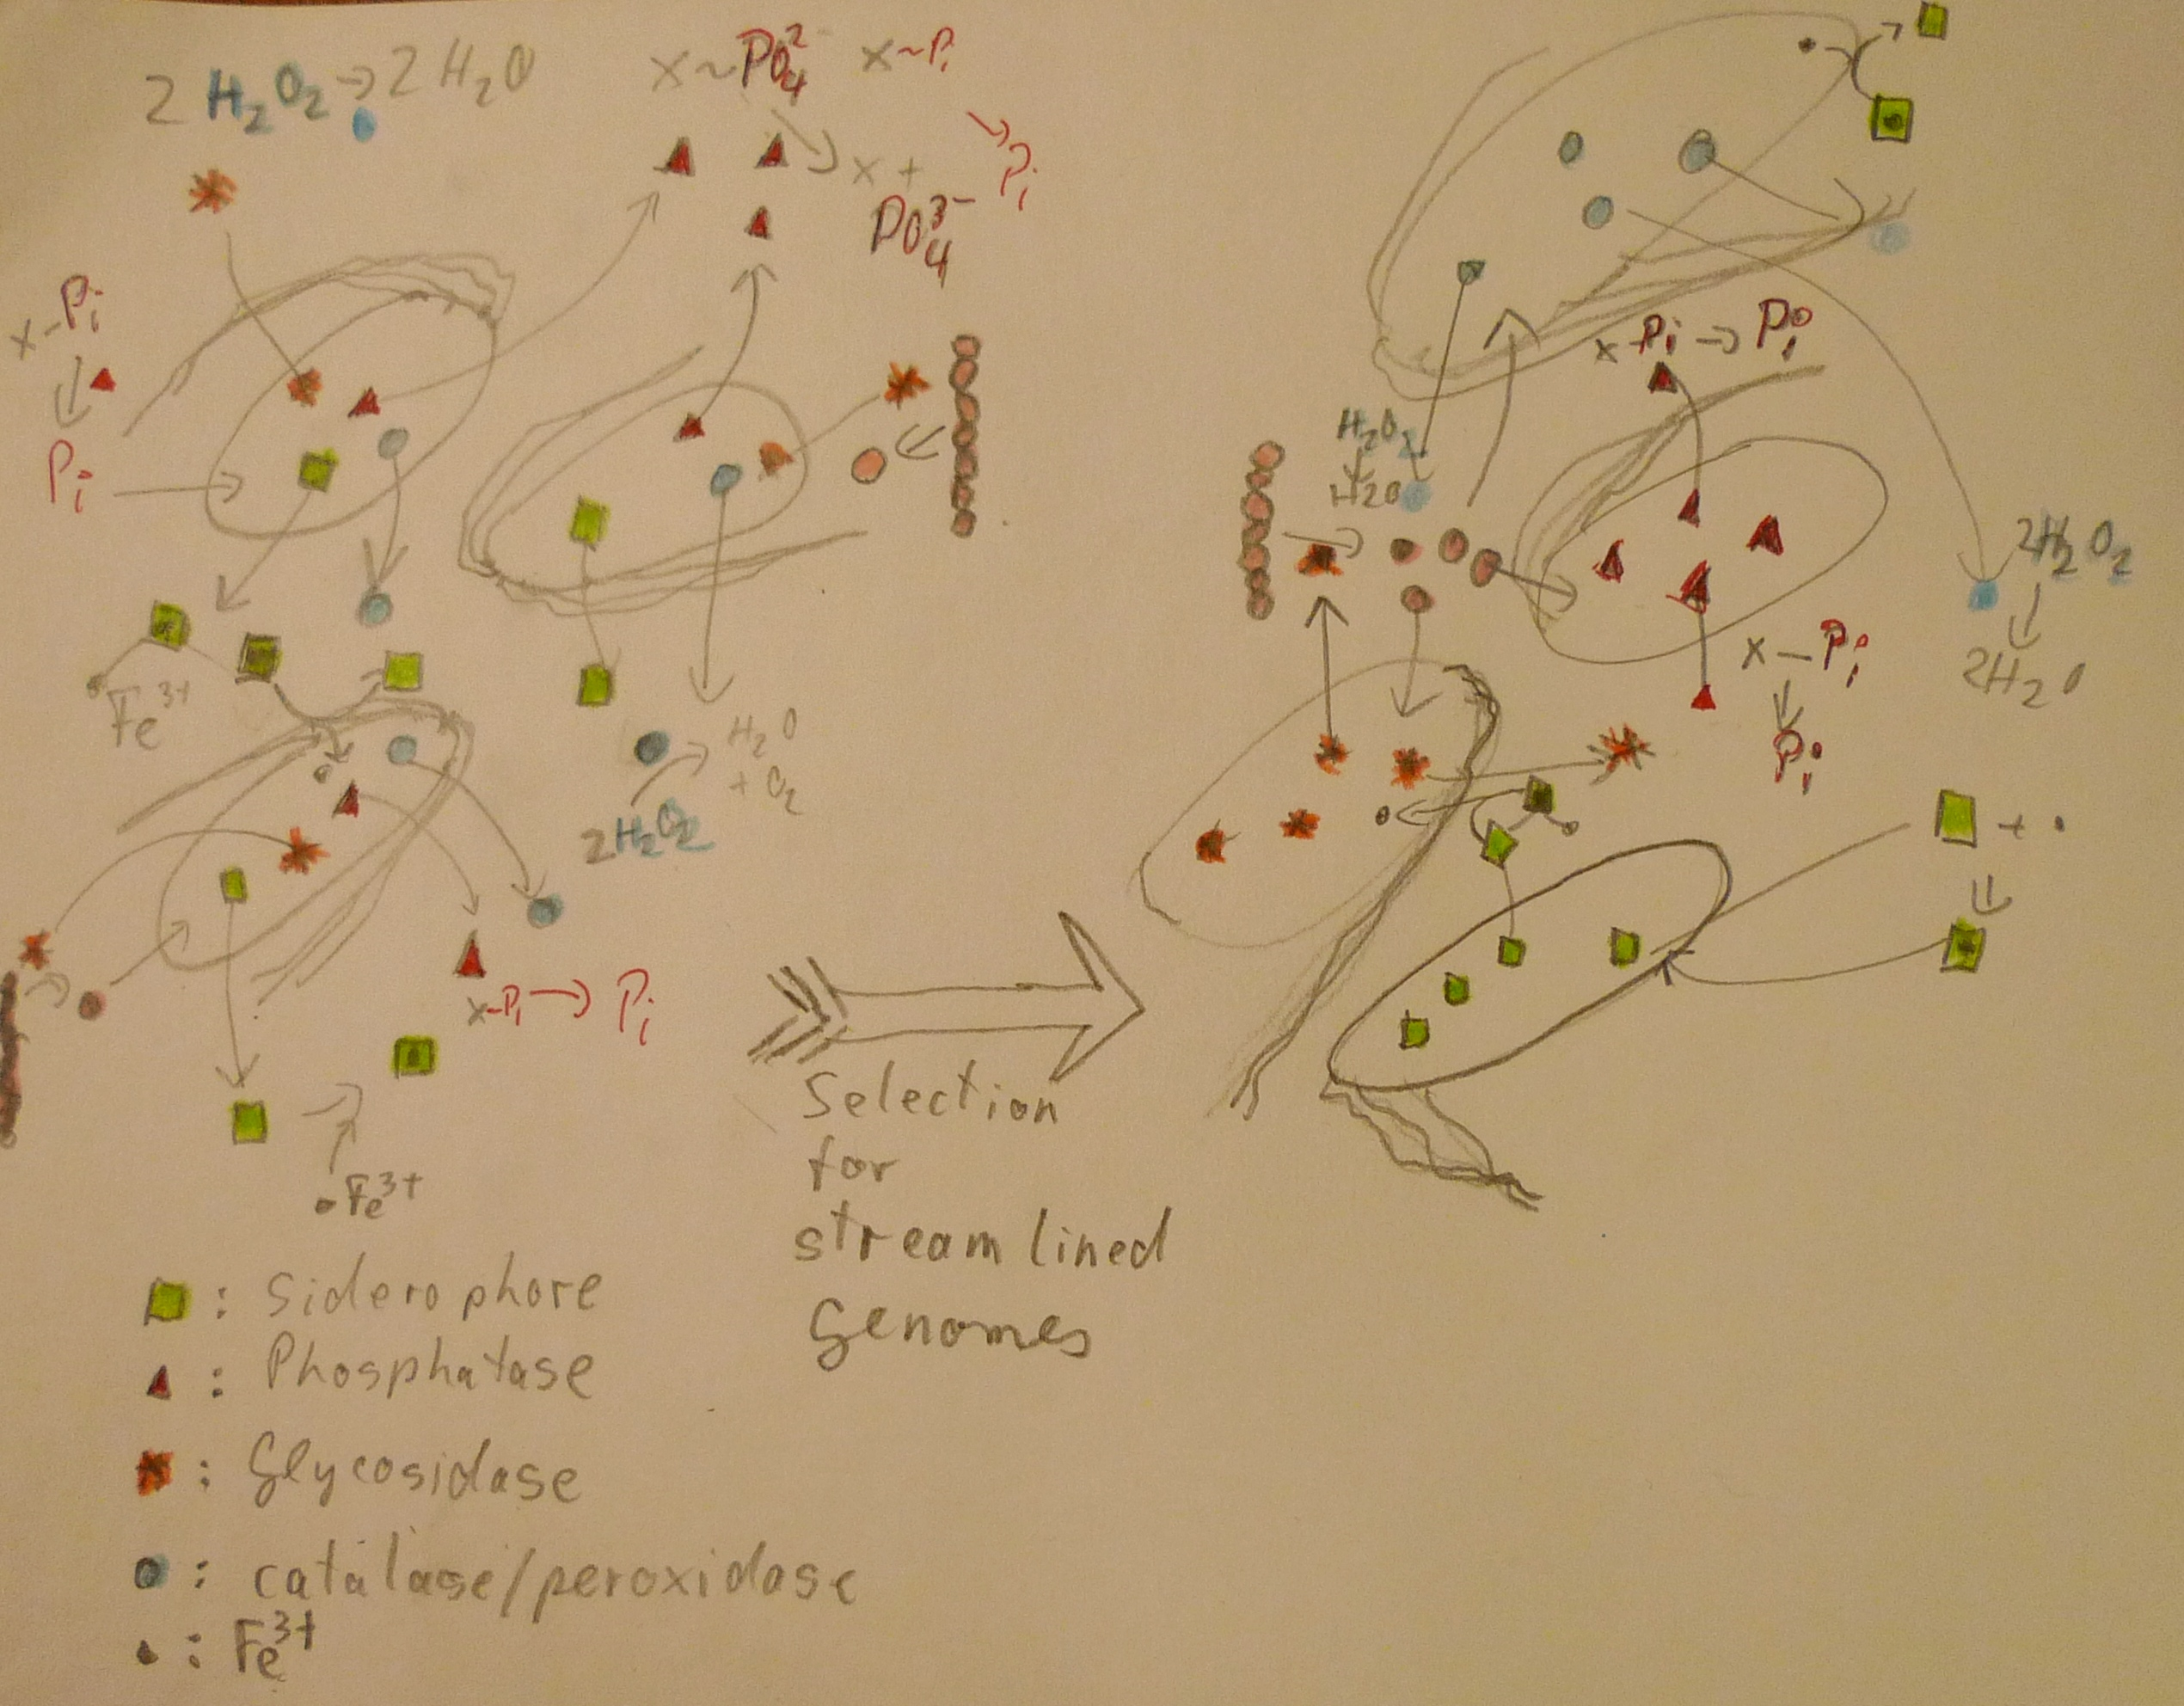
The Black Queen Hypothesis
doi: 10.1128/mBio.00036-12 23 March 2012 mBio vol. 3 no. 2 e00036-12
explains the emergence of collaboration between microbes through the loss of genes encoding common goods (leaky products). E.g.:
Start - After selection for small streamlined genomes Cells with identical genomes Cells are mutually dependent
See here for an updated version

Slide 10
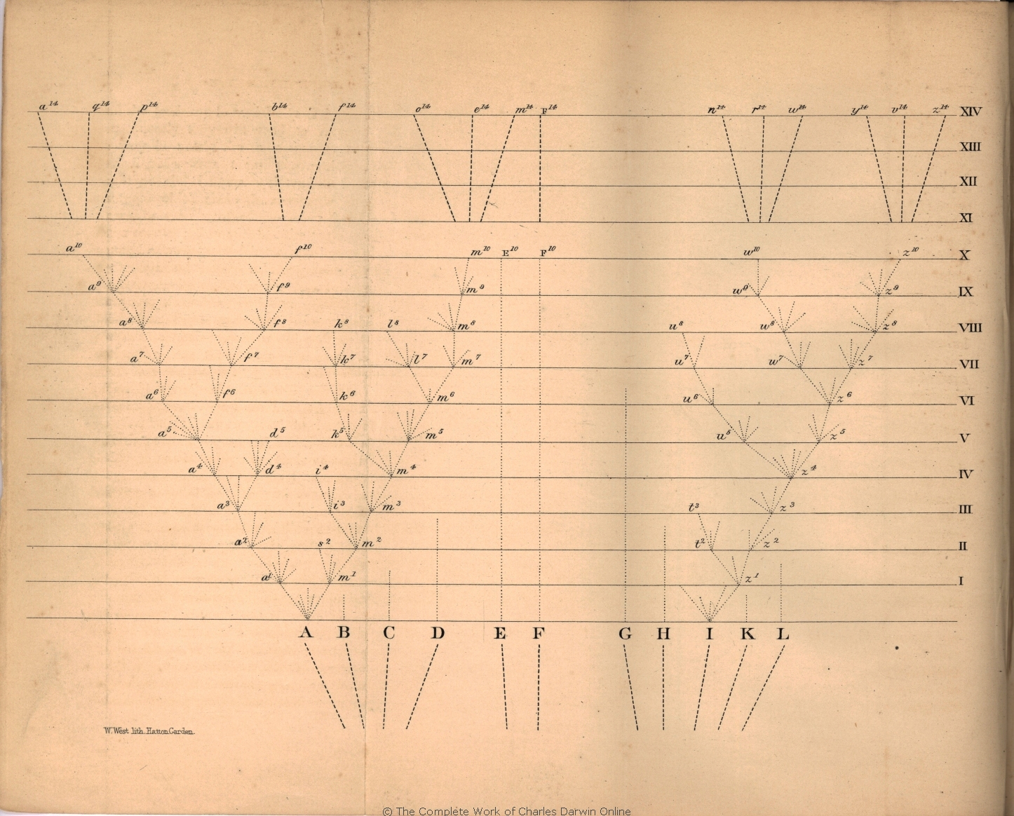
Darwinian Evolution- a slow and gradual process
In Darwin’s description evolution by natural selection was a slow and gradual process based on small inheritable variation. However, note that his aim was to establish that the “common view of the immutability of species” was wrong.
“That natural selection will always act with extreme slowness, I fully admit.”
Darwin saw fluctuations as a source for variation

Slide 11
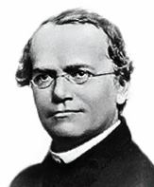
Mendelian genetics and Mutationism
Gene as unit of inhertance
Mutations cause difference in phenotype
Hugo de Vries, Carl Correns, and William Bateson
Richard Goldschmidt's hopeful monsters (1940)
Gregor Johann Mendel

Slide 12
Mutationists
Replaced Darwin’s concept of blended inheritance and fluctuations (which were shown not to be inherited) with inherited mutations.
For the most part the geneticists in the early 1900s did not doubt the process of natural selection as described by Darwin, but they saw the creative force in the mutations.
(From Arlin’s entry on mutationsm in Wikkipedia: )
“.. the mutationists saw evolution as a two-step process of the chance occurrence of a mutation, followed by its persistence or elimination (selection). The mutationists denied that selection is creative, and they gave mutation a certain measure of control over the course of evolution.”
The inclusion of genetic exchange as a process creating variation is more in line with the mutationist view than with the modern synthesis.

Slide 13
Modern Synthesis
Mutations create variation.
The individual mutation is not important.
An unlimited supply in variation is present in the population.
Selection is what causes evolution by natural selection.
Mutationists believed Mendelian genetics is incompatible with Darwin’s theory of natural selection. (See Arlin Stoltzfus’ Mutationism Myth, which debunks this claim. The proponents of the modern synthesis did not want to “stand on the shoulders of giants”.)
Julian Huxley invented the term, when he produced his book, Evolution: The Modern Synthesis (1942). Other major figures in the modern synthesis include Ronald A. Fisher, Theodosius Dobzhansky, John B.S. “Jack” Haldane, Sewall Wright, Edmond B. Ford, Ernst Mayr, Bernhard Rensch, Sergei Chetverikov, George Gaylord Simpson, and G. Ledyard Stebbins.

Slide 14
Is the concept of mutual aid in conflict with Darwin’s theory of evolution by natural selection, or only in conflict with social Darwinists?

